Slide 1
Computational Physics (Lecture 14)
PHY4061

Slide 2
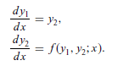
The shooting method
A simple method for boundary and eigen value problems.
First convert the second-order differential equation into two first-order differential equations
by defining y1= u and y2= u’, assume that the boundary conditions are u(0) = u00 and u(1) = u11

Slide 3
The key is to make the problem look like an initial-value problem
By introducing an adjustable parameter;
the solution is then obtained by varying the parameter.
u(0) is given already, we can make a guess for the first order derivative at x = 0,
for example, u’(0) = α.
α is the parameter to be adjusted

Slide 4
For a specific α, we can integrate the equation to x = 1 with any of the algorithms discussed earlier for initial-value problems.
Because the initial choice of α can hardly be the actual derivative at x = 0, the value of the function u_{α}(1), resulting from the integration with u’(0) = α to x = 1, would not be the same as u1.

Slide 5
The idea of the shooting method is to use one of the root search algorithms to find the appropriate α that ensures f (α) = u_{α}(1) − u1 = 0 within a given tolerance δ.

Slide 6
An actual numerical example to illustrate the scheme.
Assume that we want to solve the differential equation
u’’ = − π² (u+1)/4
boundary conditions u(0) = 0 and u(1) = 1.
Define the new variables: y1= u and y2= u’
dy1/dx = y2,
dy2/dx= − π²(y1+ 1) / 4.

Slide 7
Now assume that this equation set has the initial values y1(0) = 0 and y2(0) = α.
Here α is a parameter to be adjusted in order to have f (α) = u_{α}(1) − 1 = 0.
We can combine the secant method for the root search and the fourth-order Runge–Kutta method for initial-value problems to solve the above equation set.

Slide 8
// An example of solving a boundary-value problem via
// the shooting method. The Runge-Kutta and secant
// methods are used for integration and root search.
import java.lang.*;
public class Shooting {
static final int n = 100, ni=10, m = 5;
static final double h = 1.0/n;
public static void main(String argv[]) {
double del = 1e-6, alpha0 = 1, dalpha = 0.01;
double y1[] = new double [n+1];
double y2[] = new double [n+1];
double y[] = new double [2];
// Search for the proper solution of the equation
y1[0] = y[0] = 0;
y2[0] = y[1] = secant(ni, del, alpha0, dalpha);
for (int i=0; i<n; ++i) {
double x = h*i;
y = rungeKutta(y, x, h);
y1[i+1] = y[0];
y2[i+1] = y[1];
}
// Output the result in every m points
for (int i=0; i<=n; i+=m)
System.out.println(y1[i]);
}
public static double secant(int n, double del,
double x, double dx) {...}
// Method to provide the function for the root search.
public static double f(double x) {

Slide 9
double y[] = new double[2];
y[0] = 0;
y[1] = x;
for (int i=0; i<n-1; ++i) {
double xi = h*i;
y = rungeKutta(y, xi, h);
}
return y[0]-1;
}
public static double[] rungeKutta(double y[],
double t, double dt) {...}
// Method to provide the generalized velocity vector.
public static double[] g(double y[], double t) {
int k = y.length;
double v[] = new double[k];
v[0] = y[1];
v[1] = -Math.PI*Math.PI*(y[0]+1)/4;
return v;
}
}

Slide 10
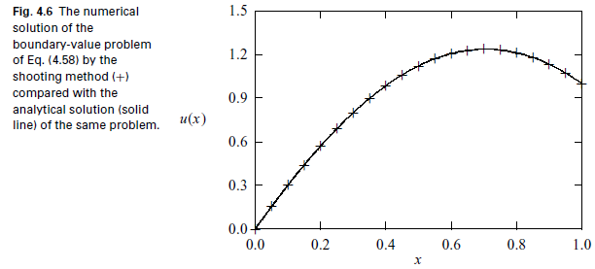

Slide 11
The boundary value problem solved in the above program can also be solved exactly with an analytical solution u(x) = cos(πx/2)+ 2 sin(πx/2)− 1.
Note that the shooting method provides a very accurate solution of the boundary-value problem.
It is also a very general method for both the boundary-value and eigenvalue problems.

Slide 12
Boundary-value problems with other types of boundary conditions can be solved in a similar manner.
For example, if u’(0) = v0 and u(1) = u1 are given,
we can make a guess of u(0) = α and then integrate the equation set of y1 and y2 to x = 1.
The root to be sought is from f (α) = u_{α}(1) − u1 = 0.
Here u_{α} (1) is the numerical result of the equation with u(0) = α.
If u(1) = v1 is given, the equation f (α) = u_{α}’(1) − v1 = 0 is solved.

Slide 13
To apply the shooting method to an eigenvalue problem,
the parameter to be adjusted is no longer a parameter introduced but the eigenvalue of the problem.
For example, if u(0) = u0 and u(1) = u1,
we can integrate the equation with u’(0) = α, a small quantity.
Then we search for the root of f (λ) = u_{λ}(1) − u1 = 0 by varying λ.
When f (λ) = 0 is satisfied, we obtain an approximate eigenvalue λ and the corresponding eigenstate from the normalized solution of u_{λ}(x).
The introduced parameter α is not relevant here,
because it will be automatically modified to be the first-order derivative when the solution is normalized.
In other words, we can choose the first-order derivative at the boundary arbitrarily and it will be adjusted to an appropriate value when the solutions are made orthonormal.

Slide 14
Linear equations
Many eigenvalue or boundary-value problems are in the form of linear equations
u’’ + d(x)u’ + q(x)u = s(x),
where d(x), q(x), and s(x) are functions of x.
Assume that the boundary conditions are u(0) = u0 and u(1) = u1.
If all d(x), q(x), and s(x) are smooth, we can solve the equation with the shooting method.
How?

Slide 15
an extensive search for the parameter α from f (α) = u_{α}(1) − u1 = 0 is unnecessary in this case
because of the principle of superposition of linear equations
any linear combination of the solutions is also a solution of the equation
We need only two trial solutions uα0 (x) and uα1 (x),
where α0 and α1 are two different parameters.
The correct solution of the equation is given by
u(x) = auα0 (x) + buα1 (x),
where a and b are determined from u(0) = u0 and u(1) = u1. Note that uα0 (0) =uα1 (0) = u(0) = u0.
a + b = 1,
u_{α0} (1)a + u_{α1} (1)b = u1,

Slide 16
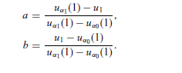
We have:

Slide 17
// An example of solving the boundary-value problem of
// a linear equation via the Runge-Kutta method.
import java.lang.*;
public class LinearDEq {
static final int n = 100, m = 5;
public static void main(String argv[]) {
double y1[] = new double [n+1];
double y2[] = new double [n+1];
double y[] = new double [2];
double h = 1.0/n;
// Find the 1st solution via the Runge-Kutta method
y[1] = 1;
for (int i=0; i<n; ++i) {
double x = h*i;
y = rungeKutta(y, x, h);
y1[i+1] = y[0];
}
// Find the 2nd solution via the Runge-Kutta method
y[0] = 0;
y[1] = 2;
for (int i=0; i<n; ++i) {
double x = h*i;
y = rungeKutta(y, x, h);
y2[i+1] = y[0];
}
// Superpose the two solutions found
double a = (y2[n]-1)/(y2[n]-y1[n]);
double b = (1-y1[n])/(y2[n]-y1[n]);
for (int i=0; i<=n; ++i)
y1[i] = a*y1[i]+b*y2[i];
// Output the result in every m points
for (int i=0; i<=n; i+=m)
System.out.println(y1[i]);
}
public static double[] rungeKutta(double y[],
double t, double dt) {...}
public static double[] g(double y[], double t) {...}
}

Slide 18
Partial differential equations
Partial differential equations in physics
In this chapter, we discuss numerical schemes for solving partial differential equations.
Several types of partial differential equations in physics.
The Poisson equation:∇² Φ(r) = −ρ(r)/ε
for the electrostatic potential Φ (r) at the position r under the given charge distribution ρ(r) is a typical elliptic equation.

Slide 19
The diffusion equation
∂n(r, t)/∂t−∇· [D(r)∇n(r, t)] = S(r, t)
for the concentration n(r, t) at the position r and time t under the given source S(r, t) is a typical parabolic equation. Here D(r) is the diffusion coefficient at the position r.

Slide 20
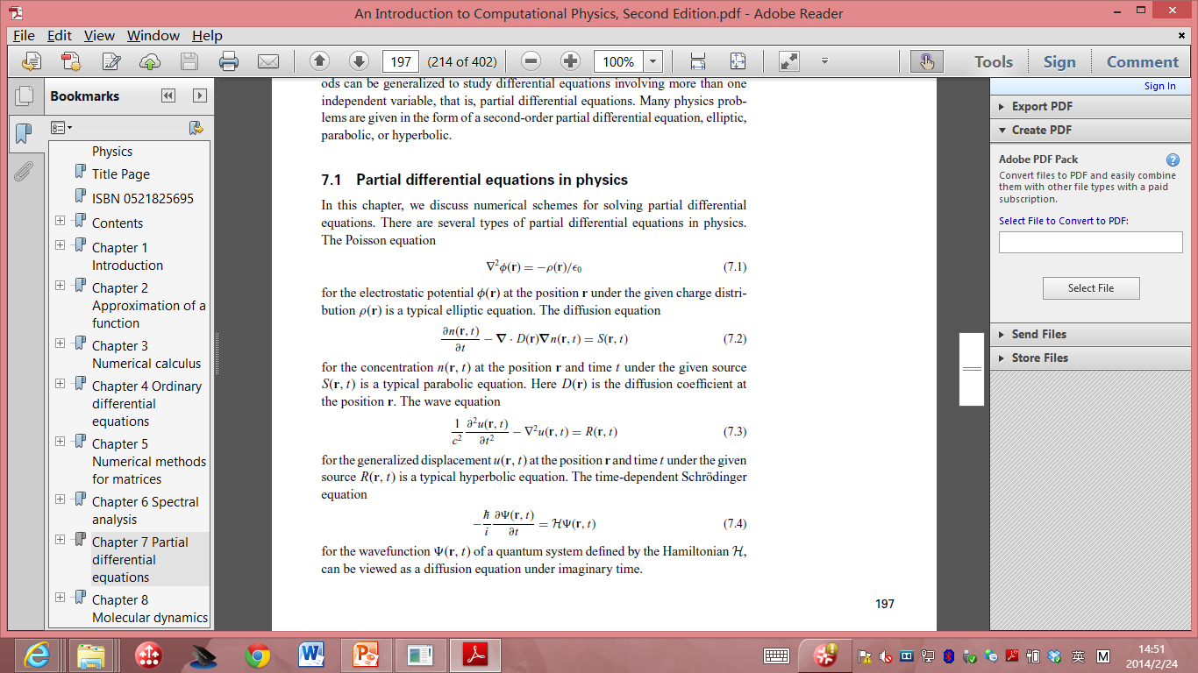
The Wave equation:
for the generalized displacement u(r, t) at the position r and time t under the given source R(r, t) is a typical hyperbolic equation.

Slide 21
The time-dependent Schrodinger equation:
for the wavefunction Ψ(r, t) of a quantum system defined by the Hamiltonian H,
can be viewed as a diffusion equation under imaginary time.

Slide 22
All the equations are linear if the sources and other quantities in the equations are not related to the solutions.
There are also nonlinear equations in physics that rely heavily on numerical solutions.
For example, the equations for fluid dynamics.

Slide 23
Separation of variables
In many cases, using a combination of the separation of variables and a numerical scheme increases the speed of computing and the accuracy of the solution.
The combination of analytic and numerical methods becomes critical in cases where the memory and speed of the available computing resources are limited.

Slide 24
Each variable (time or one of the spatial coordinates) is isolated from the rest, and the solutions of the resulting ordinary differential equations for all the variables are obtained before they are combined into the general solution of the original partial differential equation.
Boundary and initial conditions are then used to determine the unknown parameters left in the solution, which usually appear as the coefficients or eigenvalues.

Slide 25
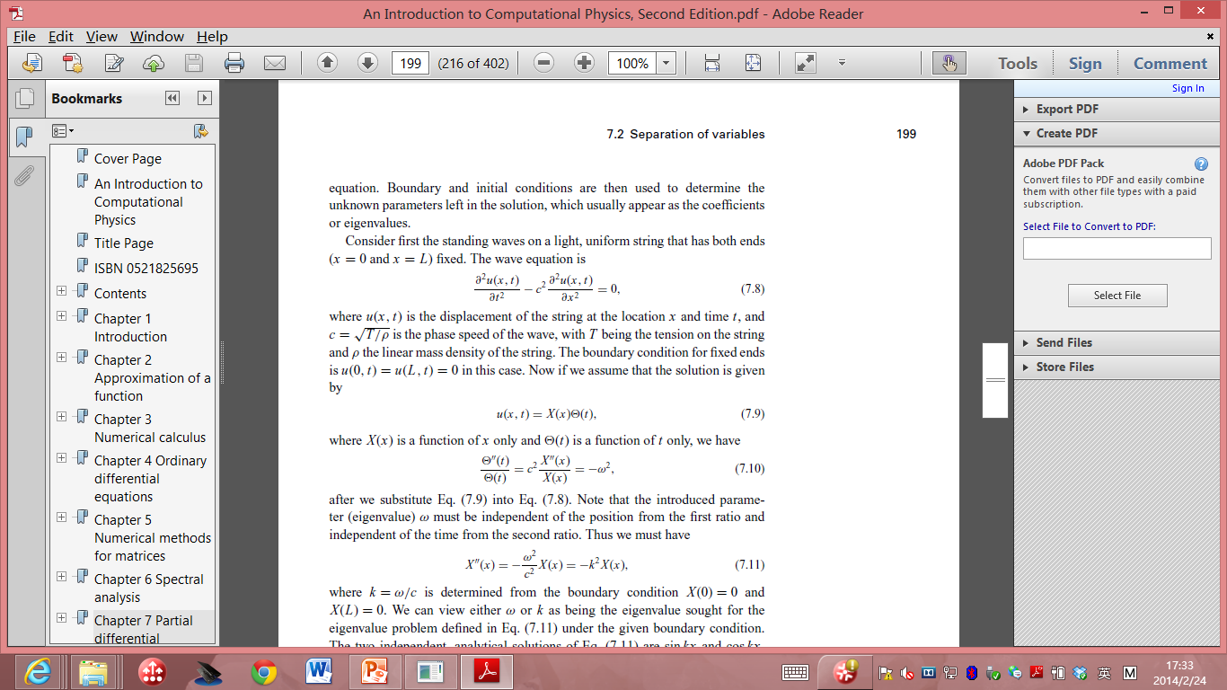
Consider first the standing waves on a light, uniform string that has both ends (x = 0 and x = L) fixed.
The wave equation is
where u(x, t) is the displacement of the string at the location x and time t, and
c =√(T/ρ) is the phase speed of the wave, with T being the tension on the string
and ρ the linear mass density of the string.

Slide 26
The boundary condition for fixed ends is u(0, t) = u(L, t) = 0 in this case.
If we assume that the solution is given by u(x, t) = X(x)Θ(t),

Slide 27
Note that the introduced parameter (eigenvalue) ω must be independent of the position from the first ratio and independent of the time from the second ratio.
we must have
where k = ω/c is determined from the boundary condition X(0) = 0 and
X(L) = 0.

Slide 28
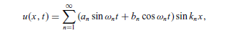
We can view either ω or k as being the eigenvalue sought for the eigenvalue problem under the given boundary condition.
The two independent, analytical solutions are sin kx and cos kx.
Then we have X(x) = A sin kx + B cos kx.
From the boundary condition X(0) = 0, we must have B = 0; from X(L) = 0,
we must have k_{n} = nπ/L
with n = 1, 2, . . . ,∞.
Using this k_{n} in the equation for Θ(t), we obtain Θ(t) = C sin ω_{n} t + D cos ω_{n} t,
With ω_{n} = ck_{n} = nπc/L
Combining the solutions for X(x) and Θ(t), we obtain the general solution
where a_{n} and b_{n} are two sets of parameters that are determined by the initial displacement u(x, 0) = u₀(x) and the initial velocity ∂u(x, t)/∂t = v0(x) when t=0.

Slide 29
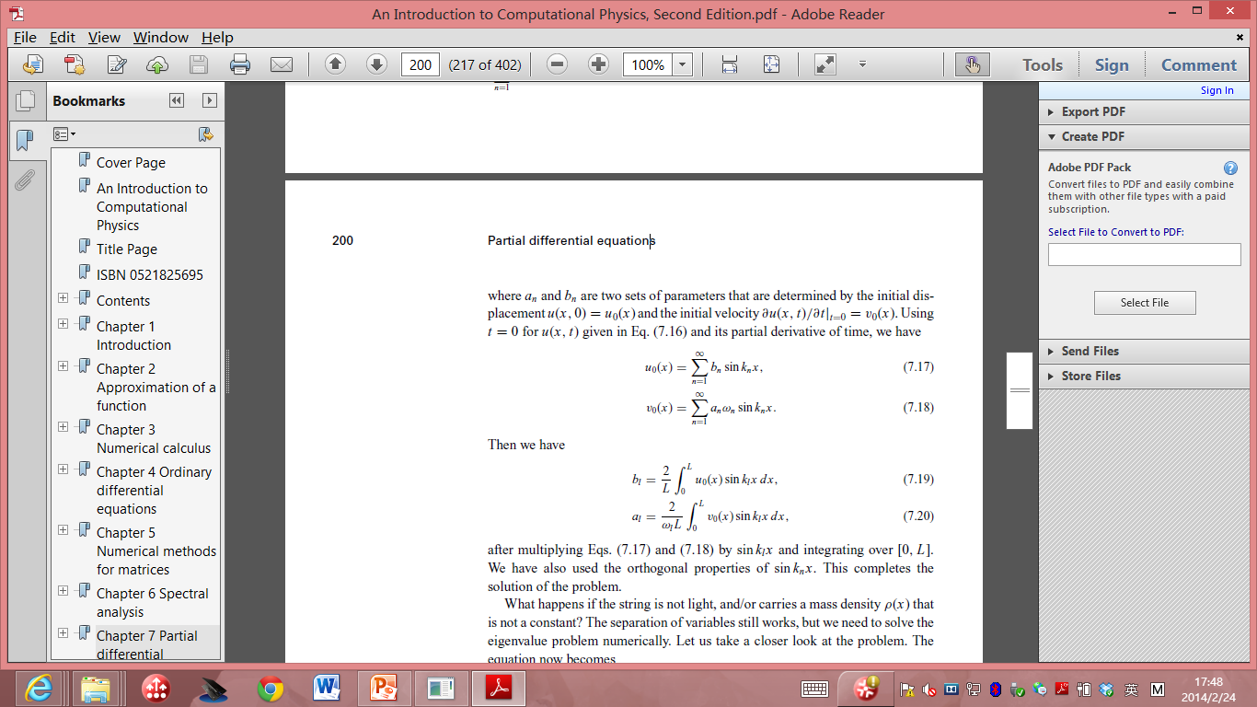
Using t = 0 for u(x, t) and its partial derivative of time, we have:

